Slide 1
INTERNSHIP PROJECT
NAME – Shubh Priyank
ROLL NO-2022UCI8007

Slide 2

INTRODUCTION
Integrated robust image comparison algorithms in AI Fabric Regression Suite which delivered Imaging APIs
Imaging APIs
Image Scaler
Image Object Remover
Image Object Extractor
This Photo by Unknown Author is licensed under CC BY-NC

Slide 3
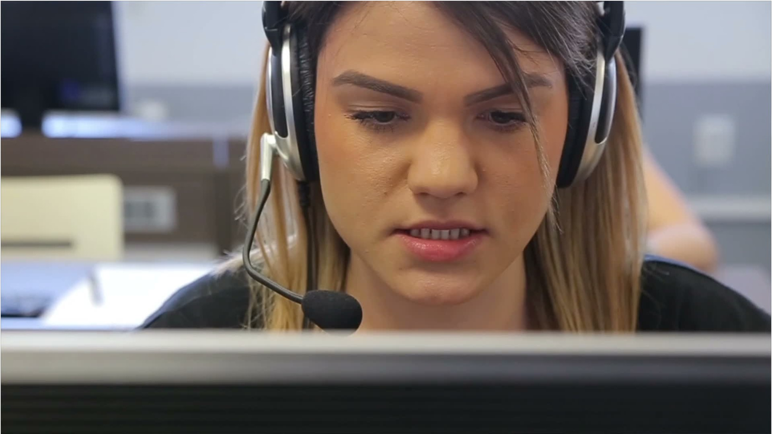
Why Existing Algorithms are not Enough??
RMS measures only pixel-to-pixel difference
pHash is a global similarity metric
Cannot detect perceptual similarity
This Photo by Unknown Author is licensed under CC BY

Slide 4
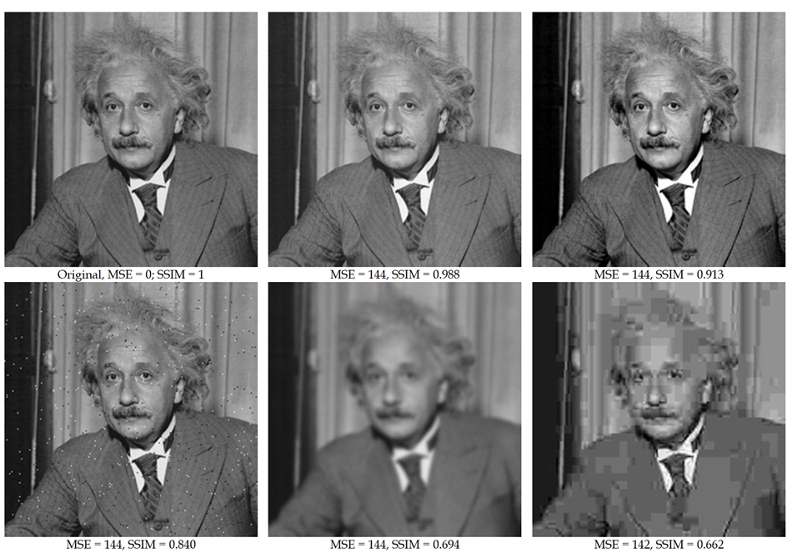
Why RMS fails ?
This Photo by Unknown Author is licensed under CC BY-NC

Slide 5
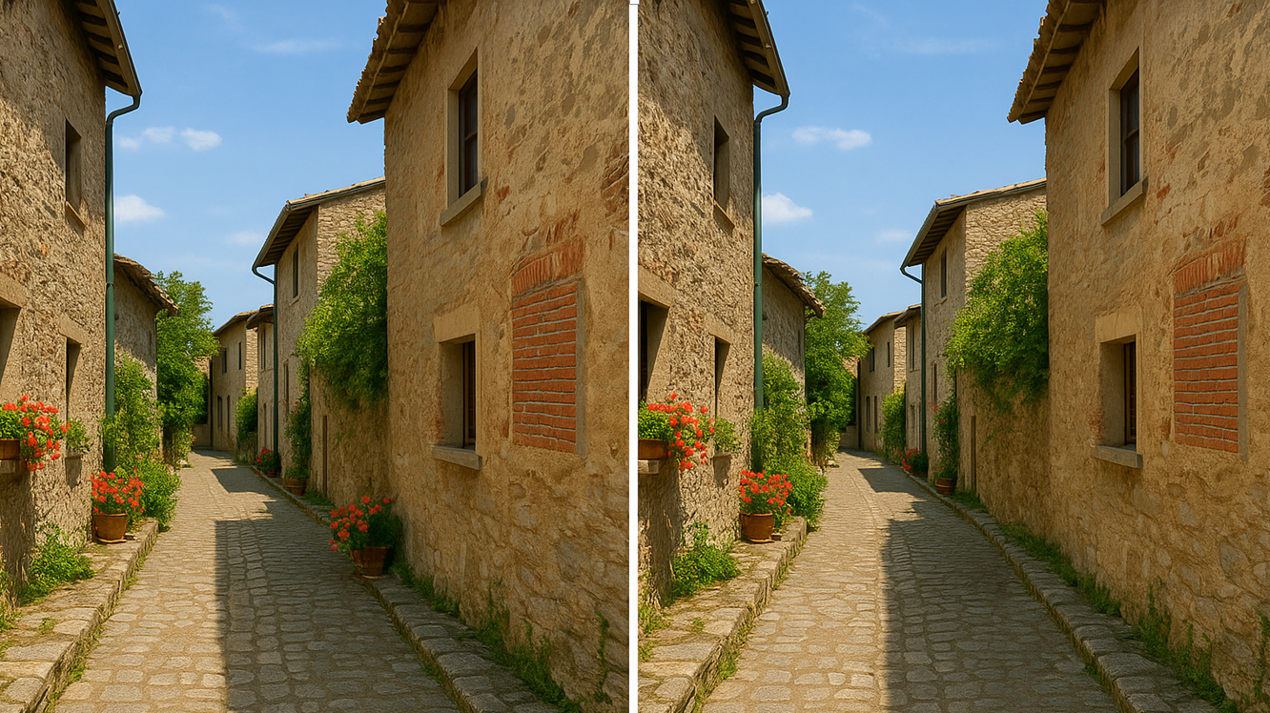
Why pHash fails ?
This Photo by Unknown Author is licensed under CC BY-NC

Slide 6
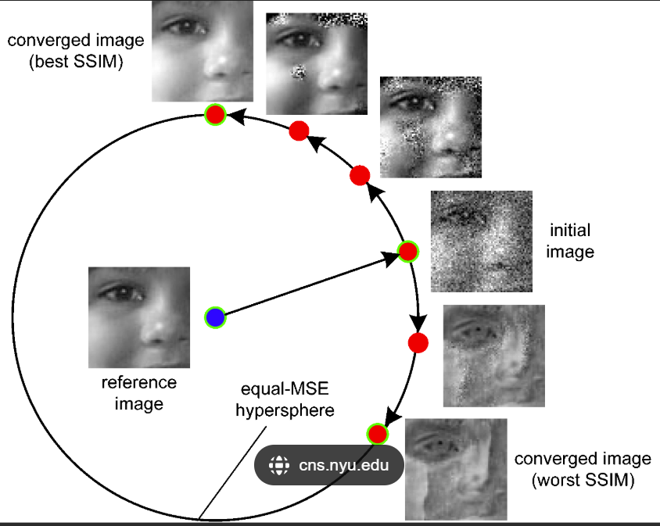
Solution : SSIM
This Photo by Unknown Author is licensed under CC BY-NC

Slide 7
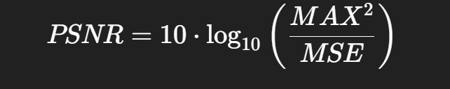
Solution : PSNR
Example 1
10 → 20
Absolute change = 10
Relative change = 100% increase (double)
Visually very noticeable.
Example 2
210 → 220
Absolute change = 10
Relative change ≈ 4.7% increase
Very small visual impact
This Photo by Unknown Author is licensed under CC BY-NC

Slide 8
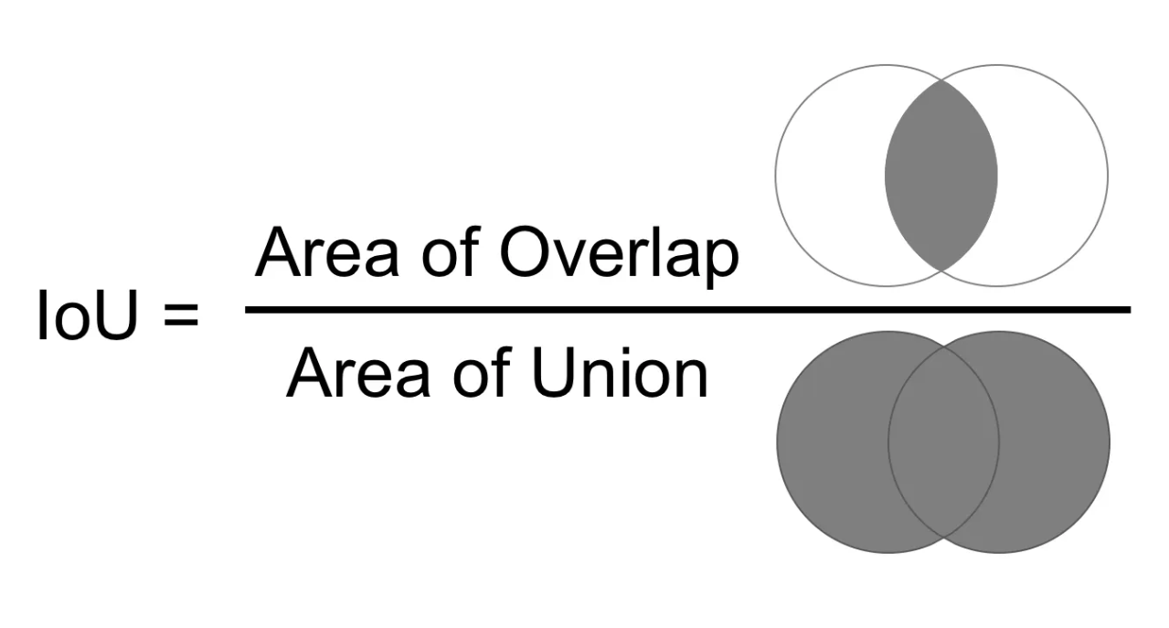
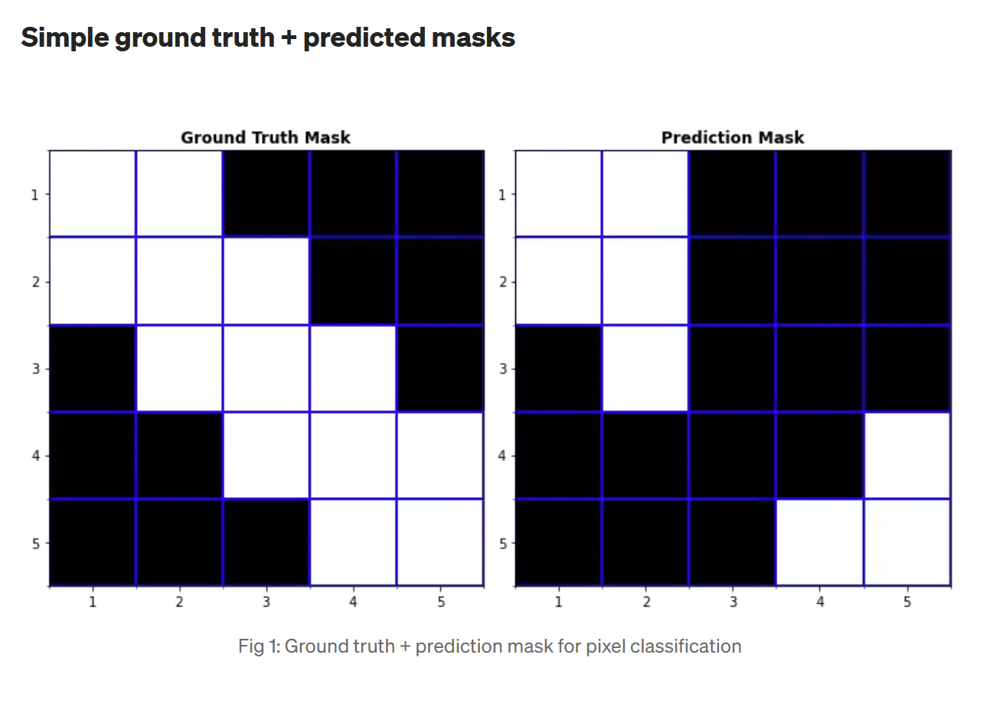
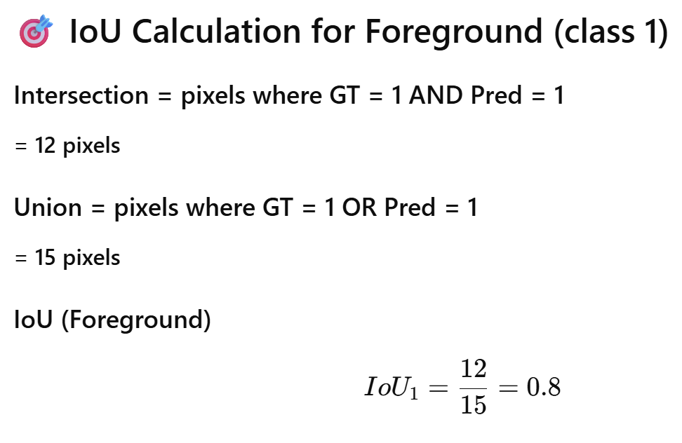
Solution : MIOU
This Photo by Unknown Author is licensed under CC BY-NC

Slide 9

TECHNOLOGIES USED
C++ Programming
This Photo by Unknown Author is licensed under CC BY-SA
Power BI : Data Visualization
YAML Script based CI/CD Pipelines
Imaging APIs : PSAPI

Slide 10
RESULTS
Integrated Robust Image Comparison Algorithm in AI Fabric Regression suite
Developed comprehensive unit test cases for each image comparison algorithm
Published structured JSON results to a Power BI dashboard for data visualization

Slide 11
FUTURE SCOPES
Defining more strict threshold for algorithm
Clip Interrogator

